Slide 1


Course Project: Phase 1

Slide 2
Reference/citation:
Step 1. Requirements (1/3)
Branches:
Each branch is identified by a unique name.
Each branch is located in a specific city.
Branches keep track of the total deposits.
Branches also keep track of the total loan amounts.
Customers:
Customers have a name.
Each customer has a unique customer ID.
Customers have a home address.
Customers may have an account (checking or savings).
Customers may take out loans.
Customers may have personal bankers or loan officers.

Slide 3
Reference/citation:
Step 1. Requirements (2/3)
Employees:
Employees (including bankers and loan officers) have unique employee IDs.
Each employee has a manager.
Employees have a start date, which allows for calculating the length of employment.
Employees have names.
Employees have home addresses.
Employees work in various locations, which can be branches or non-branch offices.
Locations:
Locations can be branches or non-branch offices.

Slide 4
Reference/citation:
Step 1. Requirements (3/3)
Accounts:
Accounts have a type (checking or savings).
Accounts can be held by more than one customer and a customer can have more than one account.
Each account has a balance.
Accounts keep track of the most recent date they were accessed by the customer.
Savings accounts have an associated interest rate.
Checking accounts keep track of dates, amounts, and check numbers for overdrafts.
Loans:
Loans originate at a particular branch.
Loans can be held by one or more customers.
The bank tracks the loan amount and payments for each loan.
Payments for loans are tracked, including the payment date and amount.
Loan payment numbers do not uniquely identify a payment across all loans, but do uniquely identify a payment for a specific loan.

Slide 5
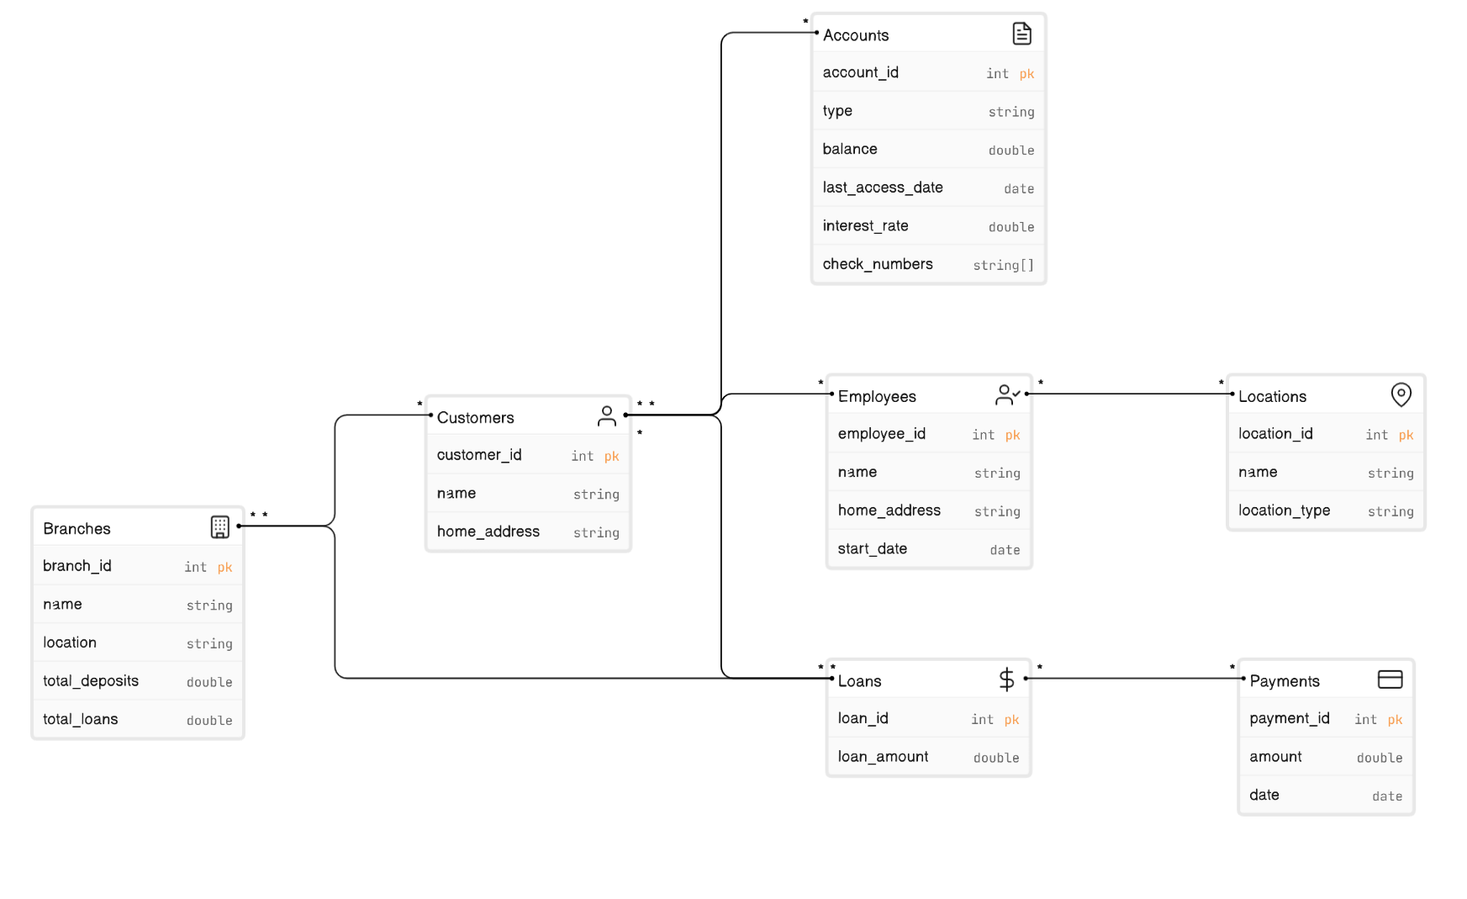
Reference/citation:
Step 2. Entity Relationship Diagram

